Slide 1
Publishing options: IReL Institutes associated authors

Slide 2
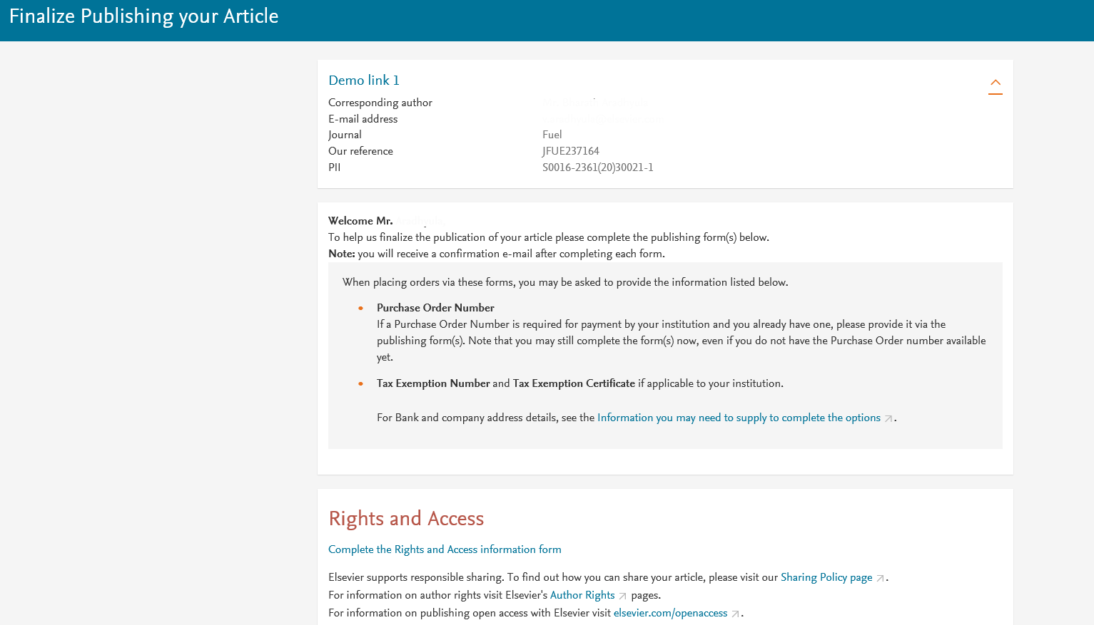
Corresponding author receives an email post acceptance with an unique link to complete the author journey and choose publishing options
Author name and email address would appear in the live system

Slide 3
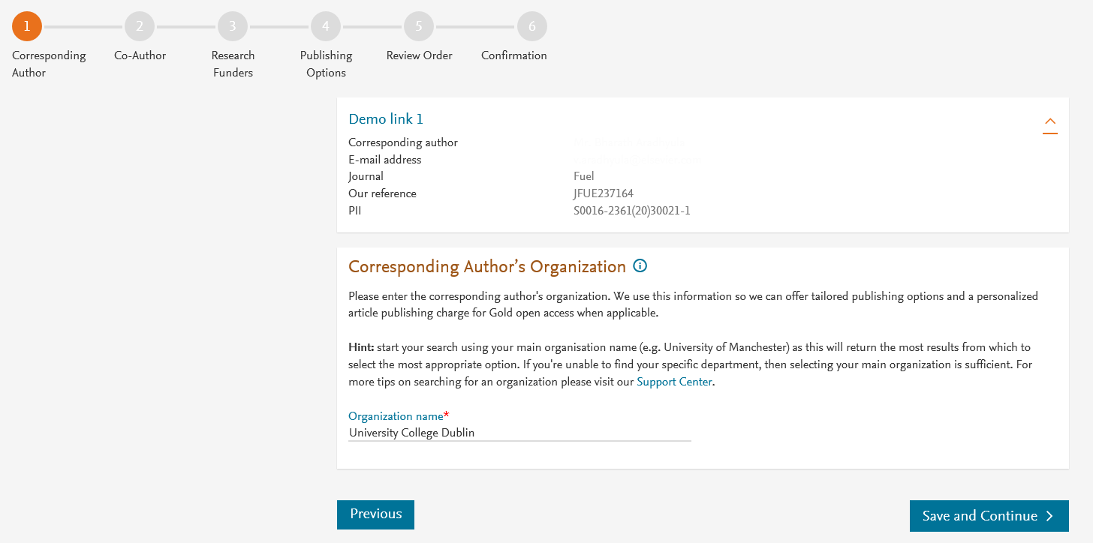
Corresponding author selects his/her affiliation details which we use to identify the authors and match them to the Ireland agreement
In this case, the author is affiliated with ‘University College Dublin’

Slide 4
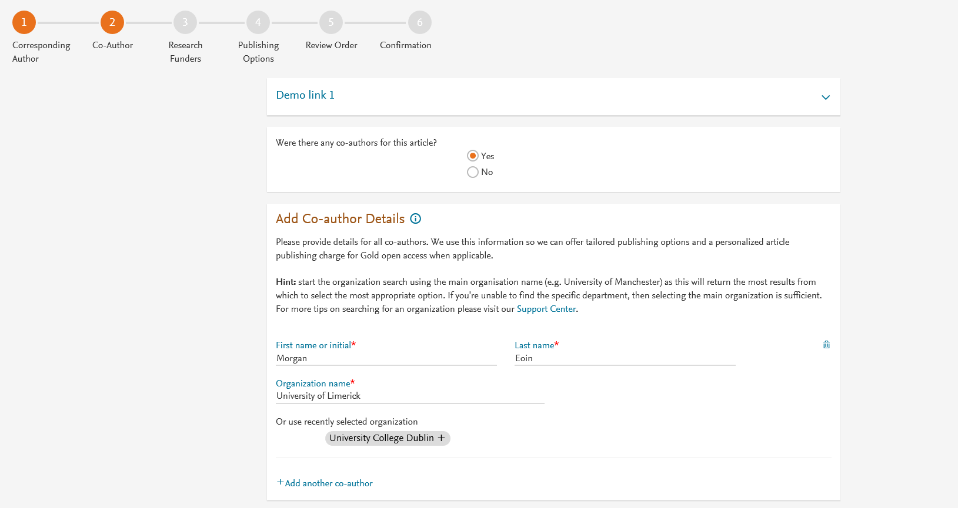
Corresponding author also adds the co-author affiliation details

Slide 5
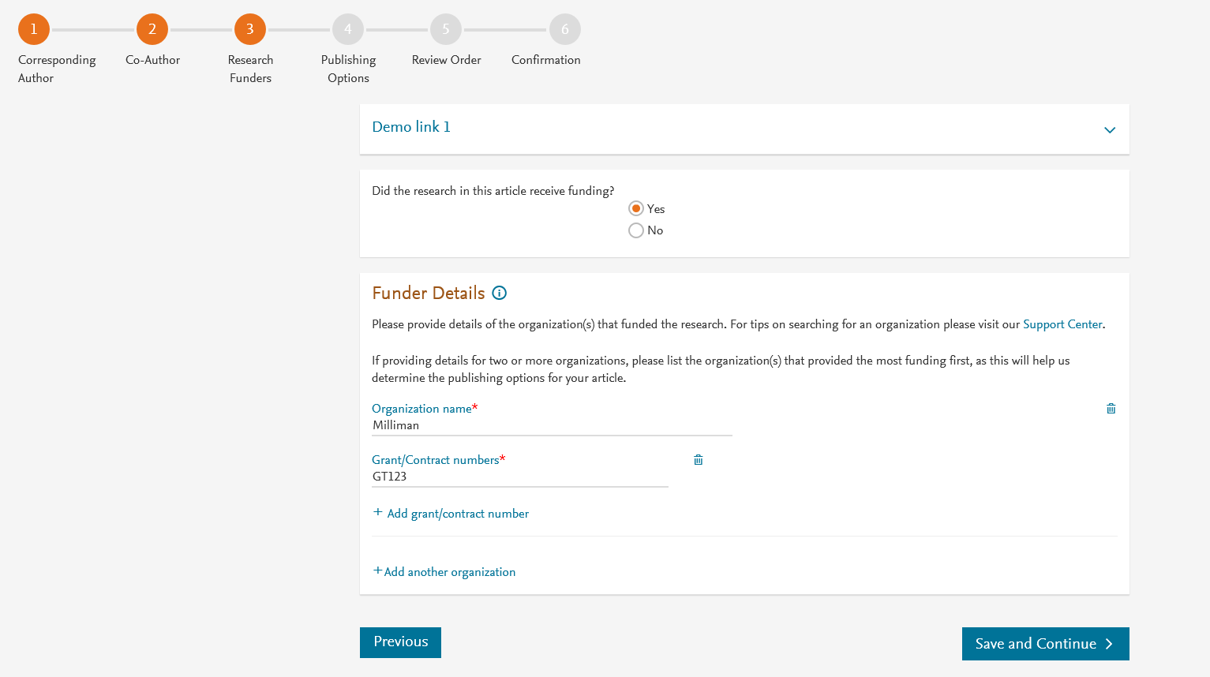
Author can add the Funder details. Funder can be the affiliated institute or a different one. In this case it is Milliman

Slide 6
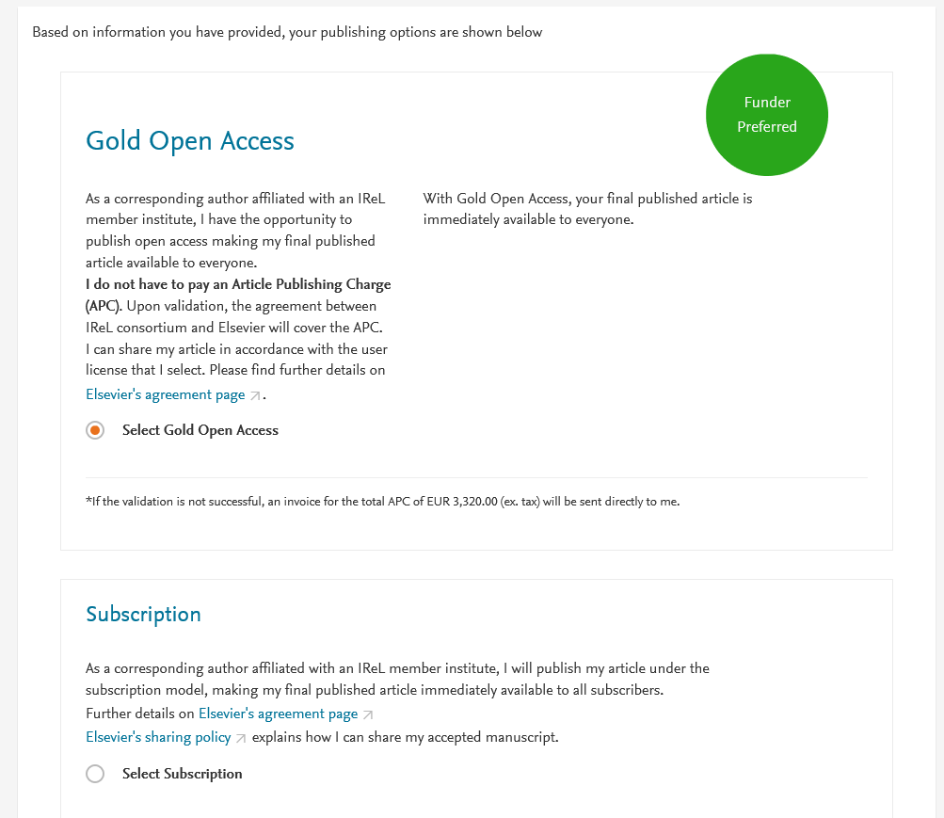
Based on the corresponding author affiliation details, the author sees the IReL Publishing Options. Gold OA option is followed by Subscription option and we make it clear that agreement covers full APC
If the librarian at the consortium rejects the author request in the Elsevier Platform, we also make it clear that the authors will receive a full price invoice
In a Hybrid journal, the author can change the article to subscription by contacting support@elsevier.com within 2 weeks in case they cannot pay for OA
We will update the text in asterisk under Gold OA option by mid February 2020
Author selects Gold OA

Slide 7
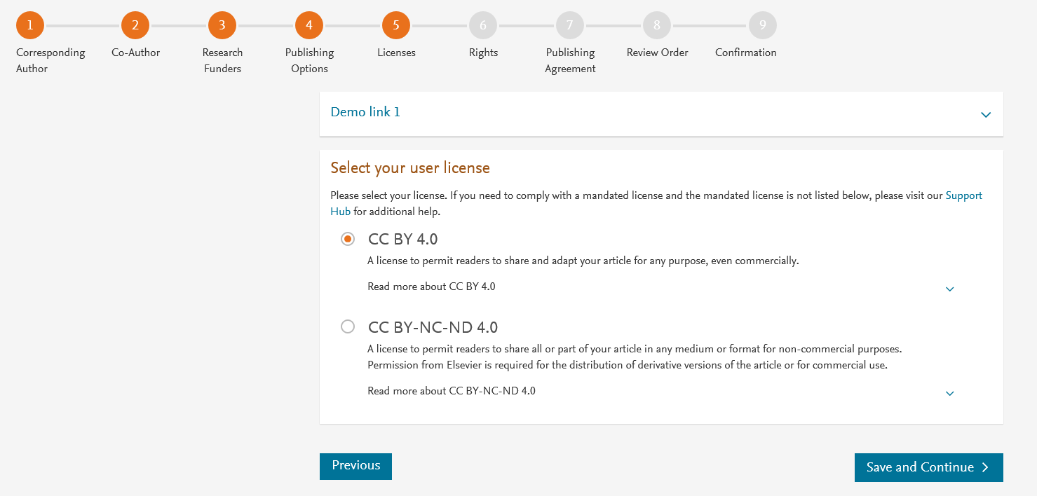
In case of OA, author selects the CC License
Author selects CC BY license in this case

Slide 8
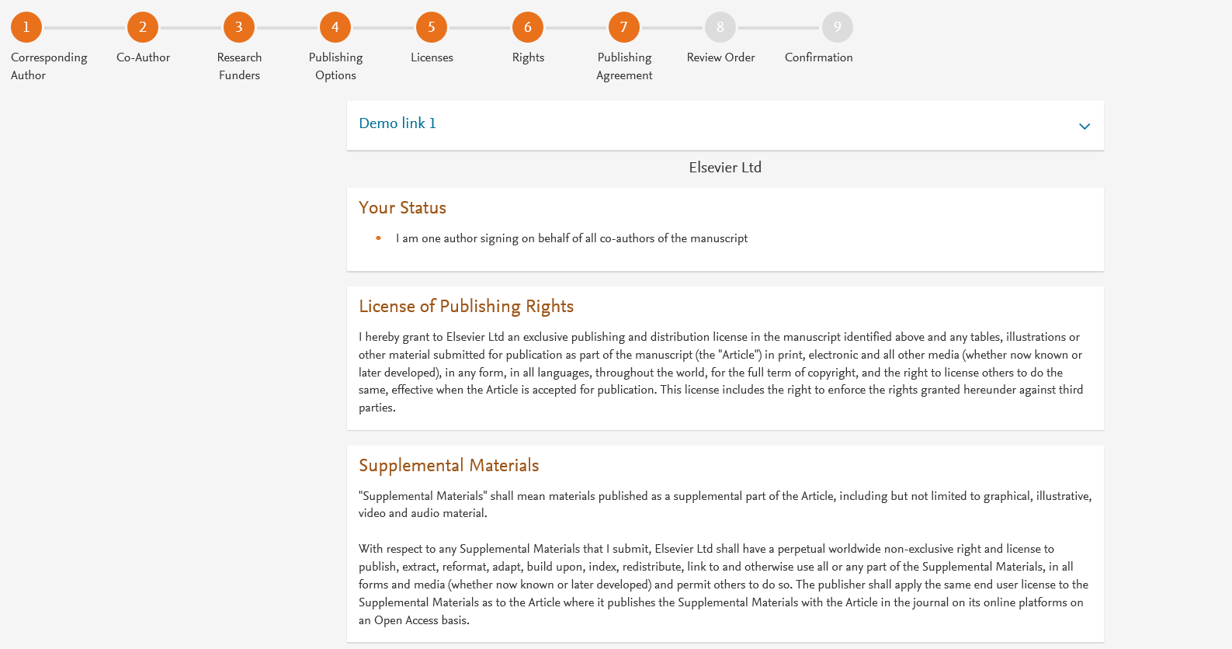
Author selects the rights

Slide 9
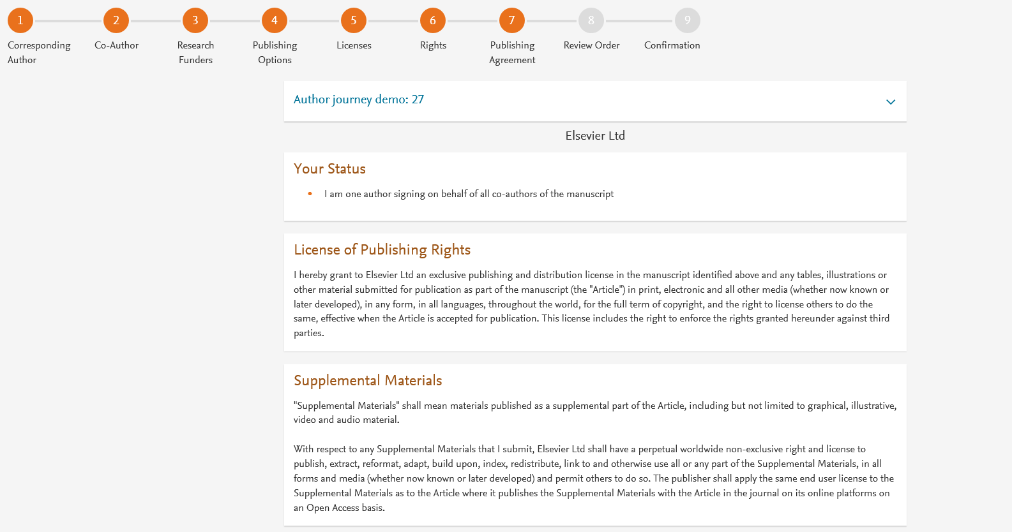
System presents author with the Journal License Publishing Agreement

Slide 10
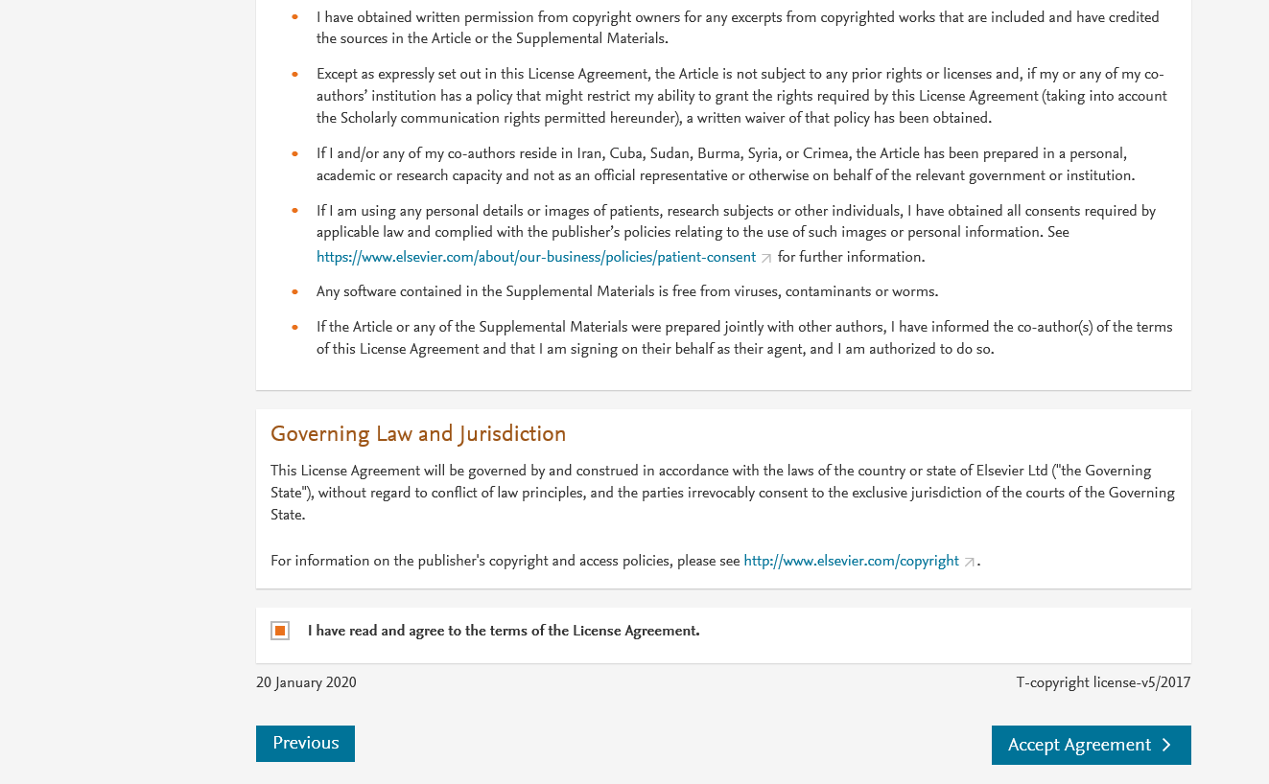
Authors agrees to the Journal License Publishing Agreement

Slide 11
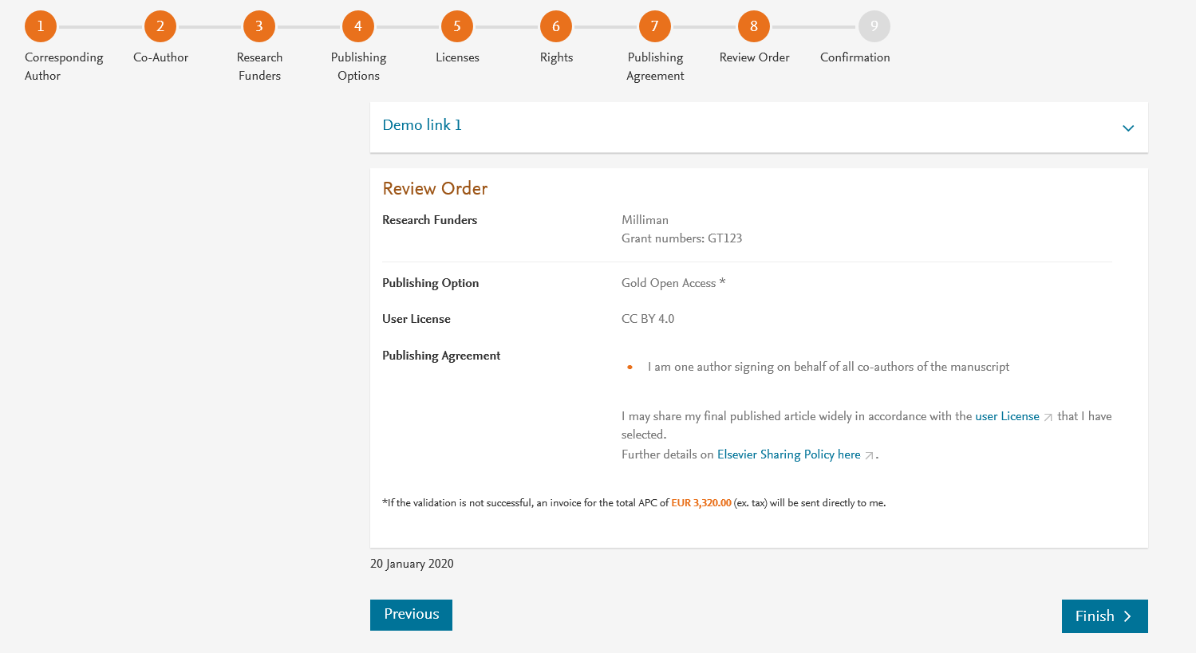
This is the summary page explaining the choices the author made in the publishing journey
Corresponding author and coauthors receive a copy of summary via email
Upon clicking ‘Finish’ Librarian at the institute will receive a notification for validation

